Slide 1

Autonomous Drone Navigation using Deep learning algorithm
PADMALAKSHMI
192225022

Slide 2
CONTENTS
Introduction to drone technology
Understanding Deep learning
Enhancing navigation with DL
Benefits of Implementing Deep Learning in Drone Navigation
Algorithms used in drone navigation
Applications of autonomous drones
Challenges in drone automation
Conclusion and future directions

Slide 3
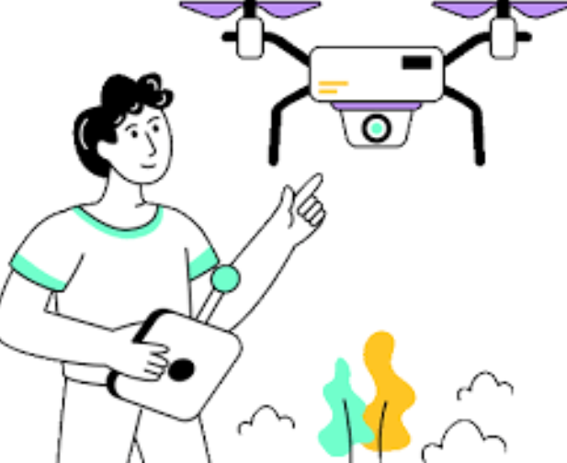
Introduction to Drone Technology
Drones have revolutionized various industries by providing autonomous capabilities. This presentation explores how Deep learning algorithms enhance drone flight, enabling them to navigate complex environments and make real-time decisions. Understanding these technologies is crucial for future advancements in aerial robotics.

Slide 4
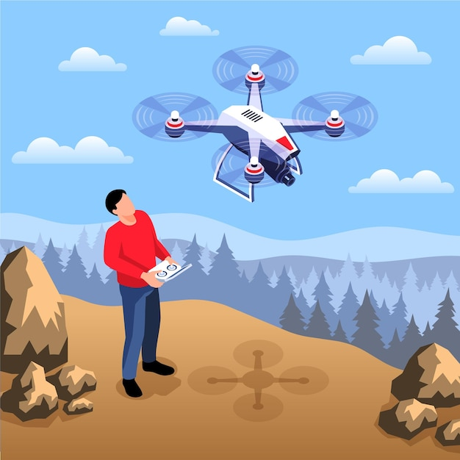
UNDERSTANDING DEEP LEARNING
Deep learning is a subset of machine learning that uses neural networks with multiple layers to analyze and extract features from complex datasets. In the context of drone navigation, deep learning enables drones to recognize objects, estimate depth, avoid obstacles, and even anticipate environmental changes.

Slide 5
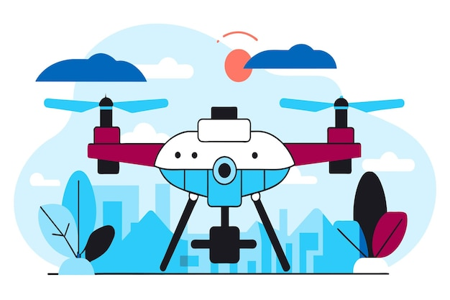
ENHANCING NAVIGATION WITH DL
Deep learning has revolutionized how drones navigate autonomously. Deep learning enhances several critical navigation tasks:
Object Detection: Identifying obstacles like trees or buildings.
Path Planning: Selecting the most efficient route from point A to point B.
Localization: Determining the drone’s position in relation to its surroundings.

Slide 6
Benefits of Implementing Deep Learning in Drone Navigation
Improved Accuracy: DL models, especially CNNs, provide better accuracy in object detection and classification, reducing the likelihood of crashes.
Real-Time Decision Making: With advances in neural networks, drones can make decisions on-the-fly, enabling seamless navigation through dynamic environments.
Adaptability: Deep learning models can generalize across different environments, allowing drones to function in new or unseen conditions without retraining.
Autonomous Learning: Through reinforcement learning, drones can continue to learn and improve their navigation abilities over time, adapting to new challenges without human input.

Slide 7
ALGORITHMS USED IN DRONE NAVIGATION
Obstacle Avoidance and Path Planning:
Deep Reinforcement Learning (DRL): DRL helps drones learn the best navigation strategies through trial and error. Algorithms like Deep Q-Networks (DQN) and Proximal Policy Optimization (PPO) allow drones to make decisions based on rewards or penalties received from previous actions.
Convolutional Neural Networks (CNNs): Used in conjunction with RL or separately for visual recognition tasks, such as identifying obstacles or specific landmarks.
Autonomous Flight and Control:
Kalman Filters and Extended Kalman Filters (EKF): Used for state estimation and sensor fusion, helping drones to maintain stable flight and accurate positioning.
Object Detection and Tracking:
YOLO (You Only Look Once) or Faster R-CNN: These are deep learning-based object detection frameworks that can be used to identify and track objects or people.
Mapping and Localization:
Simultaneous Localization and Mapping (SLAM) Algorithms: Algorithms like ORB-SLAM and RTAB-Map are used for building maps of unknown environments and localizing the drone within those maps.

Slide 8
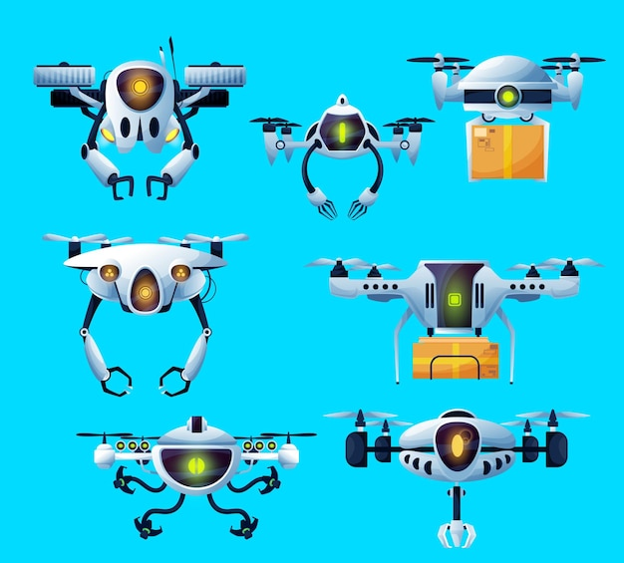
APPLICATIONS OF AUTONOMOUS DRONES
The integration of Deep learning in drones has led to numerous applications, including agriculture, search and rescue operations, and surveillance. These advancements allow drones to perform complex tasks autonomously, reducing human intervention and increasing operational efficiency.

Slide 9
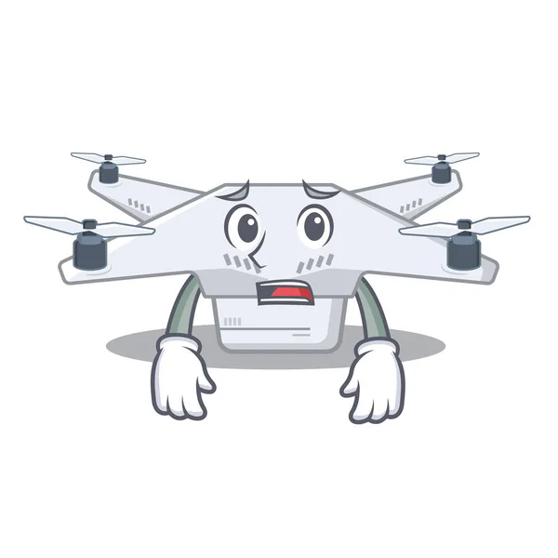
CHALLENGES IN DRONE AUTOMATION
Despite the advancements, there are significant challenges in enhancing drone autonomy. Issues such as data privacy, regulatory compliance, and environmental factors can hinder performance. Addressing these challenges is essential for the widespread adoption of autonomous drones in society.

Slide 10

CONCLUSION AND FUTURE DIRECTIONS
The integration of deep learning in drone navigation has drastically improved the autonomy, efficiency, and reliability of UAVs. However, there is still a long way to go to overcome challenges related to real-time processing, obstacle avoidance, and energy efficiency. The future of autonomous drone navigation is likely to involve more lightweight and power-efficient deep learning models, advanced hardware for edge computing, and enhanced multi-agent coordination through drone swarms.

Slide 11
THANK YOU!

